Slide 1

FRONT-END WEB DEVELOPMENT IN SITEBUILDER
Mat Mannion, Web Development Team Lead, IT Services

Slide 2
COURSE CONTENT
Fundamentals of HTML/CSS/JavaScript in Sitebuilder pages
Setting up a local development environment on your computer to prototype and build pages
Using built-in Bootstrap and ID7 components
Testing (including accessibility, cross-browser testing etc.)
Using browser development tools
Advanced CSS layouts with flexbox and CSS grids
Notes:
We’ll go through a number of topics from the fundamentals of Sitebuilder pages and how you create design and create Sitebuilder pages on your own computer, including design components and creating advanced designs using new CSS features, through testing and releasing.

Slide 3
HOUSEKEEPING
Regular breaks throughout the day
Introduce yourself:
Who are you?
Where do you work?
What do you do? (In particular, around Sitebuilder page design)
What are you looking to get out of the course?
Notes:
We’ll have regular breaks between topics in the coffee lounge. A little bit about me; I’ve been here at Warwick for 16 years in total starting out as a student and then in IT Services since 2005. I’m not a trainer; I’ll probably talk too fast, or mumble, or swear. Please feel free to ask me to slow down or repeat something, I’d much rather that than you feel like you’ve missed something.

Slide 4
Training essentials
We’ll go through topics from design, through implementation, and testing and release
Sign up to the Sitebuilder Editors Slack team: https://join.slack.com/t/sitebuildereditors/signup - use your Warwick email address
If you don’t have a Sitebuilder test site, say now!
Notes:
Join the Sitebuilder Editors Slack team - this is where we can share links and resources during the training. You can stay on it and use it to discuss your Sitebuilder pages even after this training has finished.
Does everyone have a test site that they can use to play around and create some Sitebuilder designs? If not, say now, and I’ll create one for you.

Slide 5
Exercises
Each exercise should take around 15 minutes
You can perform each exercise on your local environment, or a Sitebuilder test page. Whichever you find easier!
Some exercises lead on from the previous one
If you finish early, try the extra time challenges
Ask for help if you need it (put your hand up, or post in Slack)

Slide 6
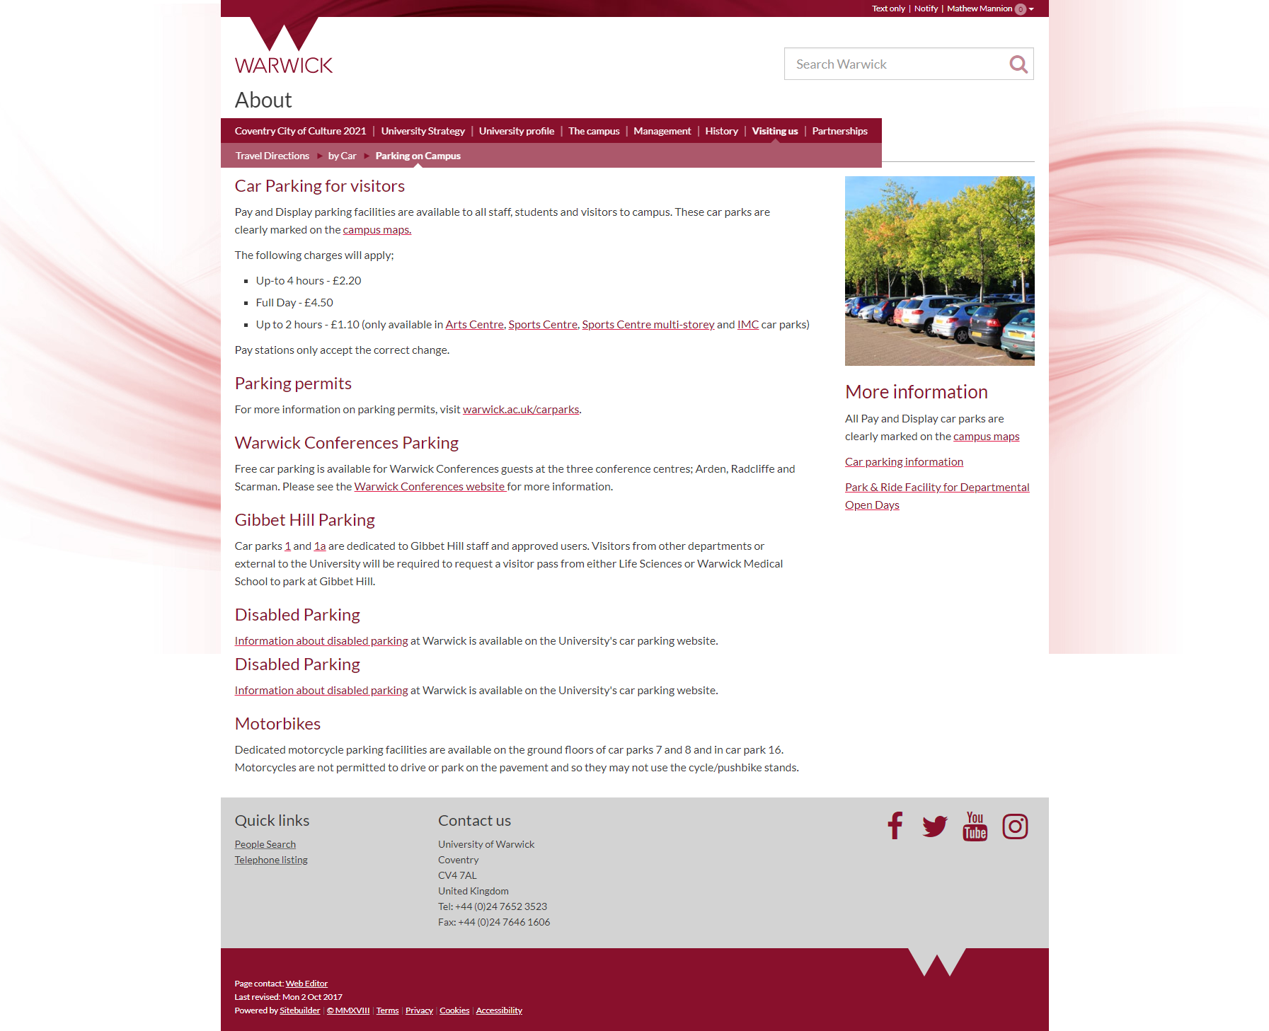
Sitebuilder page make-up
ID7 template (standard utility bar, search box, utility links in footer)
Site design (left border, right border, masthead) – colours based off brand colour
Navigation
Page title (hidden on site homepages by default)
Main content and optional right content, with a layout
Site footer
Notes:
A Sitebuilder page is made up of a number of elements:
The ID7 template (standard utility bar, search box, utility links in footer)
The site design (left border, right border, masthead) including some colours based off a brand colour
Navigation
The page title (hidden on site homepages by default)
A main content, and optionally, a right content, with a layout
A site footer
When you’re editing a Sitebuilder page, you’re only editing what’s in the main content and the right content. If you include CSS or JavaScript in-between <head> tags in the raw editor, those go into the <head> of the template after everything else (i.e. ID7 and site-specific CSS and JavaScript). You can also include <script> tags in the body of your page itself, and they stay exactly where you put them.

Slide 7
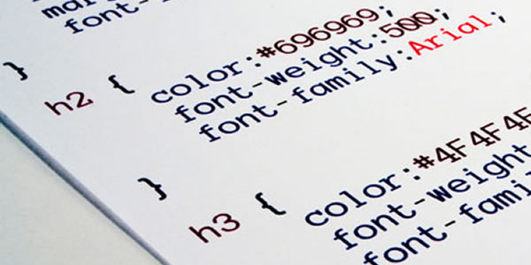
Page composition
The HTML of the page (what you see in the content editor)
The site-specific CSS and JavaScript (controlled by the ITS Web Team)
Same on any web page in the same Sitebuilder site
Any page-specific CSS and JavaScript
Notes:
When you’re designing a page you’ve got the following:
The HTML of the page (what you see in the content editor)
The site-specific CSS and JavaScript (controlled by the ITS Web Team)
Any page-specific CSS and JavaScript
You could put your page-specific CSS and JavaScript straight into the page in <style> and <script> tags but usually you’re going to want to link to a CSS or JS file you’ve uploaded into Sitebuilder so it can be maintained easier or be used on multiple pages.

Slide 8
Template page
<html>
<head>
<!-- Page-specific styling (page.less) -->
<link type="text/css" href="page.css">
<!-- Page-specific JavaScript -->
<script type="text/javascript" src="page.js"></script>
</head>
<body>
<p>No page content yet.</p>
</body>
</html>
Notes:
With our template page we’ve got a lot of boilerplate but this is the equivalent in the Sitebuilder raw editor.
This is how you’d get code out of visual studio and into a Sitebuilder page

Slide 9
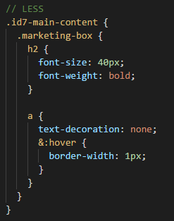
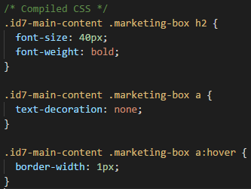
Notes:
Once you get beyond basic CSS, it can be useful to use .less files instead of .css files. Less is a powerful extension to CSS that lets you do things like use variables, or nest your rules. When you upload a .less file to Sitebuilder, it runs a processor on it that converts it to a .css file at the same time, ready for including in your page.
You can either upload your .less file straight to Sitebuilder, then edit it in the Files tab, or you could design your Sitebuilder page on your own computer then upload everything at the end. We recommend doing the latter as it’s generally faster and makes it easier to collaborate. We’ve created a template to get you started, using Visual Studio Code as the editor.

Slide 10
Getting a local development environment
Needs an editor, a local webserver and a template
Create as many of these as you want, store them somewhere (like on a shared drive or in git) – collaborative editing
You can get the template from https://github.com/UniversityofWarwick/sitebuilder-page-template
We recommend Visual Studio Code and the Live Server extension
Notes:
After this slide, go through the setup process on a laptop. Make sure everyone has it installed! If anyone can’t get it installed, give them a template Sitebuilder page

Slide 11
Exercise 1.1: Use a .less file to change the style of a page (15 minutes)
If you’re using the template in Visual Studio Code, you’ll just need to edit the page.less file with the changes you want to make (e.g. try making all the text red, or the font size bigger, or something)
If you’re using a Sitebuilder page on a training site, you’ll want to create a .less file on your computer then upload it
Try using less-specific features like variables and nesting
Extra time exercise: Try changing the whole ID7 brand (look at site.less in the template)
Don’t do this normally, or we’ll be mad!

Slide 12


Undergraduate Study
Internal project to implement design for new undergraduate study campaign homepage
Mostly achieved through Less (and a small amount of JavaScript to resize the video in the header and drive the course search typeahead)
Fully responsive, cross-browser, based on core ID7

Slide 13
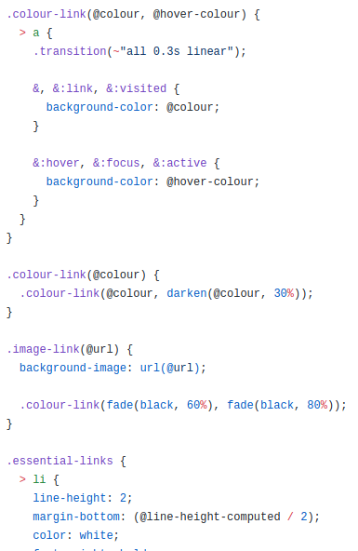
Using variables and mixins from ID7
Not currently documented, potentially subject to change (but unlikely)
Source code is public (and patches accepted!) – github.com/universityofwarwick/id7
less/variables.less defines a bunch of useful variables that can be used elsewhere; equally there are some useful mixins in the various files
Most commonly used:
@grid-gutter-width – the standard width between columns horizontally (vertically: use (@line-height-computed / 2))
.link-colour(@colour) or .link-colour(@base, @hover)
.link-decoration(@base, @hover)
Beware anything in mixins/branding.less

Slide 14
Exercise 1.2: Using standard ID7 variables in styling (15 minutes)
Create a class you can apply to a div that gives it a background of @id7-brand-red-bright and padding of @grid-gutter-width
You’ll need to change the text colour as well when you put something in it!
Extra time exercise: Set a custom link colour using the .link-colour() mix-in

Slide 15
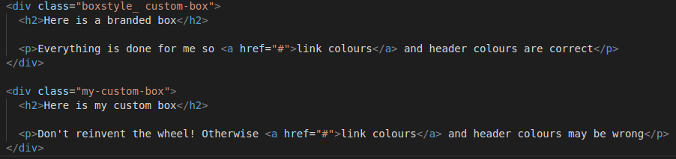
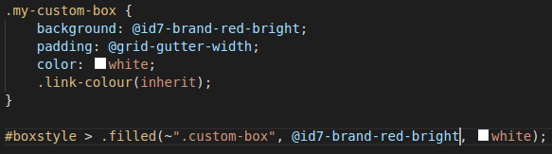
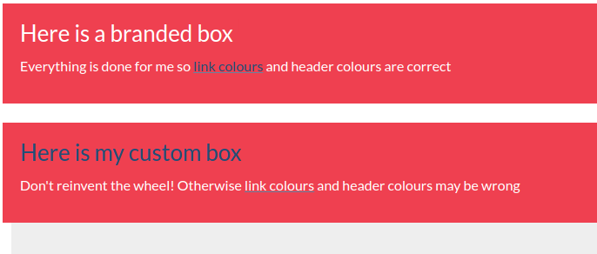
Notes:
Don’t reinvent the wheel!

Slide 16
JavaScript is a powerful tool (used sparingly)
JavaScript is code that runs on the computer of the person looking at the web page
You can use it to build rich, interactive web-pages on the client side
It’s often used to add a bit of “glitz” to your page – but make sure it’s progressive enhancement so your page still works without JavaScript (accessibility / search engines)
If you’re using lots of custom JavaScript, consider whether you should be using standard components
Most of the time you shouldn’t need to resort to JavaScript
ID7 Libraries (included on every page
jQuery (no-conflict)
jQuery.doubleScroll
Bootstrap 3
Font Awesome 4.7.0
Typeahead.js
Lodash
Modernizr
Notes:
JavaScript can be used to create incredibly complicated web applications that run inside the user’s browser. It can be used to create interactive elements but, for the most part, should be used sparingly for accessibility reasons and because a search engine won’t execute it. It’s good practice to start from a page with no JavaScript at all and then use it to add embellishments like tabbed interfaces or accordions. Most of the time, you shouldn’t need to resort to JavaScript and we’ll only touch on it briefly in this course – we only want to give you enough that you’re able to use standard components from ID7 and Bootstrap; building lots of custom JavaScript can make it difficult to maintain particularly as people move on.

Slide 17
Exercise 1.3: Using jQuery to add JavaScript functionality to a page (15 minutes)
We’ll add a link in our div and when you click it, we’ll hide that div
Extra time exercise: Instead of just hiding the div, make it fade out slowly and slide content up

Slide 18
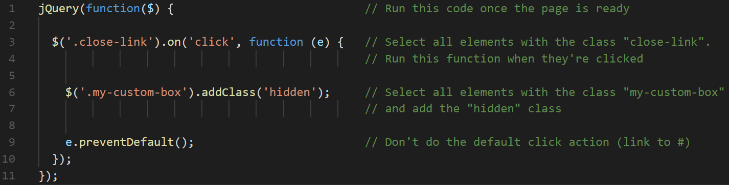
What’s happening here?

Slide 19

Notes:
Coffee break

Slide 20

Storing your code
Sitebuilder isn’t a development environment
No history for files
GitHub is a host for a distributed control system (based on Git) – it stores changes to code and history, but can get complicated
At the very least, consider storing your code on a shared drive
Notes:
Now that you’re starting to write code, there are better ways to store it than just uploading it to Sitebuilder (e.g. Sitebuilder doesn’t [at present] store history for uploaded files). As you can see, the ID7 code itself is stored on GitHub which is a version control system - at its core, it’s a permissions-aware shared drive that you can check code out of and check code back into. When you’re collaborating with other people, it’s especially handy because you can see differences.

Slide 21

Using built-in ID7 components
CSS and JavaScript-driven components from the Bootstrap UI framework
Documentation at https://getbootstrap.com
ID7 uses Bootstrap v3.3.7 – make sure you change the dropdown in the top right of the documentation!
Bootstrap 4 components won’t work
Generally you include some HTML, and maybe some JavaScript, and they just work
http://id7.warwick.ac.uk/examples/bootstrap-testcard
Tip: Use sparingly, where appropriate – visually busy, draws the eye
Font Awesome 4.7.0 for iconography
Notes:
ID7 is built on Twitter’s Bootstrap UI library and includes a number of components on top of it that you can use to add user interface elements - you’ll see these in use across internal University of Warwick applications but you can also use them in rich Sitebuilder pages where it’s appropriate to do so.

Slide 22
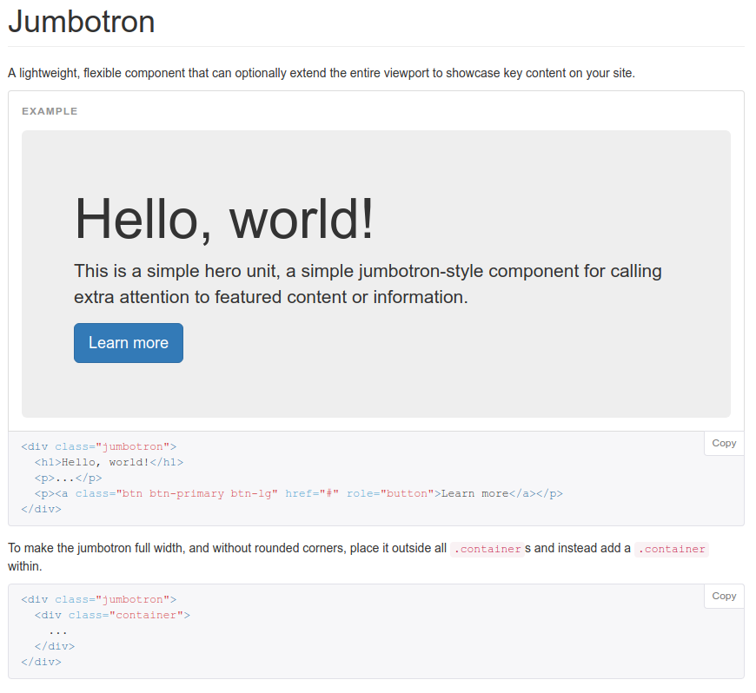
Pure CSS components: Labels, badges, panels etc.
Consistent styling for UI elements and embellishments
All you need to do is copy the HTML into place and modify it to suit your needs
You can see most of them on the test card
In the Bootstrap documentation: under “Components”
Notes:
Many of Bootstrap’s components just provide consistent styling for UI elements, and all you have to do is copy the HTML into place and modify it to suit your needs.
Most of these can be seen on the ID7 demo site: http://id7.warwick.ac.uk/examples/bootstrap-testcard/
The Bootstrap documentation (make sure to select v3.3.7) at getbootstrap.com has all of these under “Components”.

Slide 23
Exercise 2.1: Add a jumbotron to your page (15 minutes)
Use the Bootstrap documentation: https://getbootstrap.com/docs/3.3/components/#jumbotron
Beware: You’ll need to wrap your jumbotron in <div class="container-fluid"> in ID7
Extra time exercise: Style your jumbotron with your .less file

Slide 24
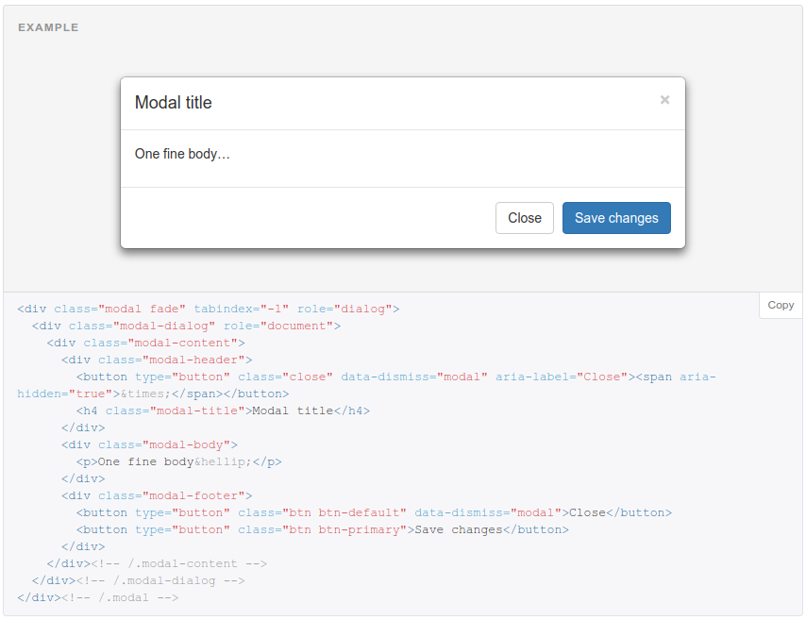
JavaScript-driven components: Modals, tabs, accordions etc.
Interactive elements with consistent styling
Generally require HTML, along with some JavaScript to trigger the behaviour
In the Bootstrap documentation under “JavaScript”
Notes:
Some Bootstrap components use JavaScript to drive the experience, but generally you just have to use HTML in the right format from the documentation. Sometimes you might need to add a bit of JavaScript to turn certain functionality on - it’ll say this in the documentation.

Slide 25
Exercise 2.2: Embed a YouTube video in a modal (25 minutes)
Use the button in your jumbotron to open a modal with a YouTube video in it
Add a Close button in the footer of your modal
Extra time exercise: Add JavaScript to automatically stop the video playing when you close the modal

Slide 26
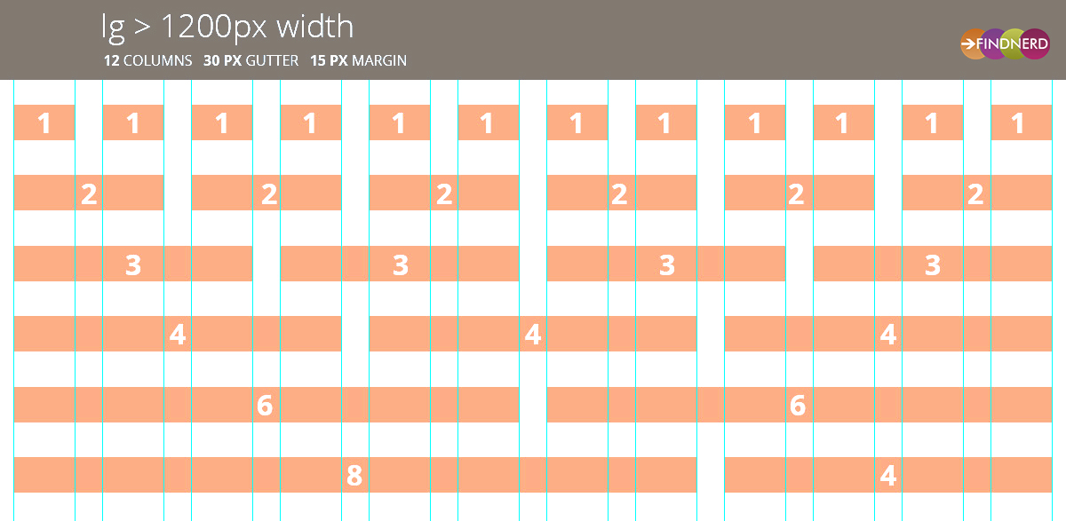
The grid system
Splits the page up into 12 columns, can combine elements to fit within
You can change the number of columns or only activate at certain breakpoints – mobile-first
Useful utility classes – flush-left, flush-right, full-width etc

Slide 27

FontAwesome
You can add iconography to your page simply by adding <i class="fa fa-iconname"></i>
All ID7 pages include FontAwesome 4.7.0
Icons can be coloured just like normal text in CSS. Useful classes brand-text and brand-bg based on your brand colours
Use fa-fw to have all icons be the same width
List of icons at https://fontawesome.com/v4.7.0/icons/
Notes:
Font Awesome is a set of font icons ideal for use in websites and user interfaces. Font icons have several benefits over images. They:
Remain sharp when scaled
Look sharp on high pixel density screens
Can be styled using the font css property (e.g. size and colour)
Font Awesome is included in ID7/SiteBuilder by default.

Slide 28
Exercise 2.3: Implement some common Bootstrap clichés (30 minutes)
It’s time to bring it all together and implement a bunch of common patterns you see in page designs:
Flush “hero” imagery
Rows of icon links
Content boxes
Large blockquotes
Notes:
Time to earn your lunch

Slide 29

Notes:
Lunchtime

Slide 30
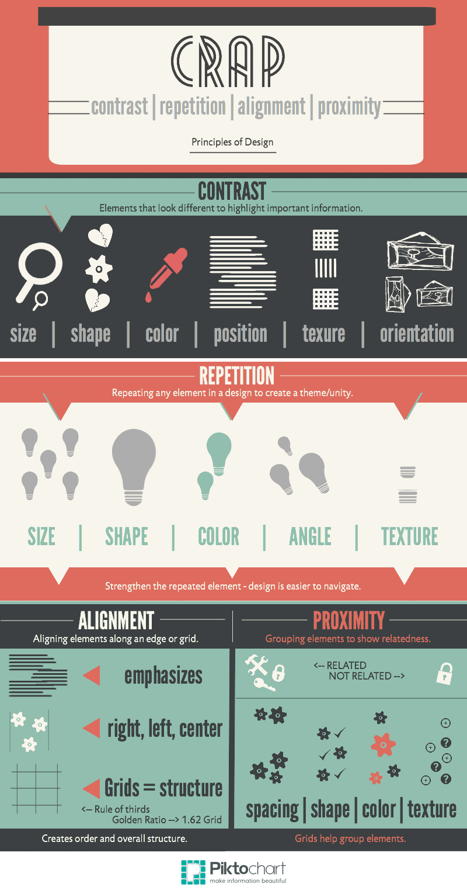
Notes:
CRAP design – Robin Patricia Williams
C – Contrast
R – Repetition
A – Alignment
P – Proximity
However, it’s not always that you can objectively point out the qualities (or flaws) in a design — especially, when you’re not a designer.
The four design practices, when applied together, lead to brilliant designs more often than not.

Slide 31
Notes:
Contrast is all about making distinct elements stand out. Contrast is used to drive a user’s attention to specific elements in a design. You can apply lots of different types of contrast in a design:
Contrast of colour is one of the most fundamental design principles, and the one which most of us are familiar with. Nevertheless, its application can still prove to be tricky for many of us. This contrast can be established using a combination of colours that lie opposite to each other on a colour wheel. Make sure they don’t cause eye strain. We’ll look at colour contrast in the testing section.
Use size, particularly with text, to structure your content. Heading sizes should represent the structure of the document – this is also used by machines (e.g. Google) to scan your page for structure. Also call-to-action buttons tend to be large, coloured, central.

Slide 32
Notes:
Repetition is how you maintain consistency in a design. It helps users familiarize with the way information is presented to them. For instance, bullet lists use repetition of circular dots to present information. The repetition of dots help readers scan and read the list quickly. Additionally, the repetition of elements is what gives an identity to a design. Repetition can be practiced with the colour, shape, texture, size, and other attributes of the elements in a design.
Consistency of size, shapes, colours, spacing…

Slide 33
Notes:
Alignment dictates the way every element is placed in a design. Alignment is a concept that advocates organizing information to create order. With alignment, no element in a design is positioned arbitrarily. Each element visually connects to other elements, leading to cohesiveness in a design. The two basic kinds of alignment are edge alignment and center alignment. (i.e. either the edges line up, or the centres line up)
Centered alignment can work when there is not a great amount of text. (But, the same style when applied to a big chunk of text can prove to be difficult to read.)
The principle of proximity states that elements that are associated with each other should be placed closely (grouped together), and vice versa. The application of proximity, especially in web design, can lead to better user experience. An amateur designer might try to utilize the complete real estate of a design, trying to spread elements evenly throughout. Such a design will make it difficult for users to determine elements that are related to each other (and those which are not), resulting in poor user experience.
Example: Headings with 2x margin-top to margin-bottom, so more closely associated with the text below

Slide 34
Testing and QA
Your pages need to be usable across devices, and accessible to all
Some requirements are mandatory, legal requirements (i.e. would contravene for example disability legislation)
Web Content Accessibility Guidelines (WCAG) 2.0
All sites are expected to meet AA standard
Notes:
There are a few things you need to consider with each page to make sure that it’s accessible. Some of these are legal requirements, they must not be ignored!

Slide 35

Assisted vs. Unassisted users
Users may use assistive technologies (e.g. screen readers or magnification)
Unassisted users may not use technology but still need to be taken into account (e.g. colour-blindness)
Don’t put text in images
Don’t hide content on the page
Use semantic HTML in a logical order
Don’t use colour to infer meaning
Use descriptive link captions, alt text, sr-only CSS class, aria attributes
Notes:
Users may have difficulties that require assistive technology (e.g. screen readers, or increasing the font size etc.) or access unassisted but still need things taken into account (e.g. colour-blindness). Most of the general things are learnt through experience, but some tips:
Don’t put text in images
Don’t hide content on the page
Use semantic HTML elements and have page content in the correct logical order (you can use CSS to have it laid out differently, but the structure should be correct)
Don’t use colour to infer meaning; don’t expect someone to click a red or green button when they may not be able to tell the difference - label the button appropriately for meaning
Descriptive link captions, sr-only CSS class, aria attributes

Slide 36
Sitebuilder text-only mode
Try accessing a few web pages on the website in Text only mode (click the link in the utility bar at the top)
Does the page still make sense? Is some of the meaning lost?
It’s (too) easy to forget about users who aren’t looking at the full fat graphical version of the web page

Slide 37
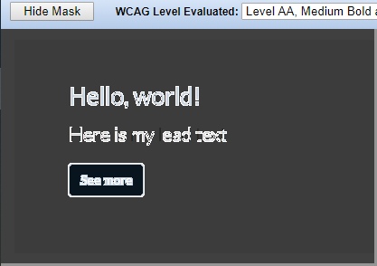
Contrast
One of the biggest issues for partially sighted users
Certain levels must be met for WCAG AA, for small and large text
Larger text can be used with less contrasting colours because it’s easier to read
Lots of online tools to check colours
Chrome “Color Contrast Analzyer” extension (right) highlights sufficiently contrasting colour boundaries
Notes:
One of the most common mistakes people make is insufficient contrast when they choose colours. Websites have a legal obligation to ensure access to blind and partially-sighted customers. Someone with poor eyesight will find it much more difficult to read low contrast - WCAG 2.0 guidelines define a standard for small non-bold text and large bold text - the latter is easier to pass. Must pass AA, ideally will pass AAA.
Show the Color Contrast Analyzer Chrome extension.

Slide 38
Exercise 3.1: Checking colour contrast (15 minutes)
Check the contrast of colours in your alert box at WCAG AA and AAA
Change your less file until it passes WCAG 2.0 AA or AAA
Extra time exercise: Use the built-in less contrast() function to automatically choose a colour based on the background

Slide 39
Consistent spacing
Two variables define horizontal and vertical spacing in less:
@grid-gutter-width – the space between columns
@line-height-computed – the space between vertical elements
Sometimes it’s okay to break this (e.g. flush up to the sides)
Visually appealing and easier to parse for users (less cognitive load) if the spacing is consistent between pages
Notes:
Pages are much more visually appealing and easier to parse for users if they have consistent horizontal and vertical spacing throughout the page (it’s fine to have occasional exceptions, particularly where you have content that’s flush to both edges or the navigation or footer).
Horizontal spacing is defined by the variable @grid-gutter-width (20px). When you’re adding padding or spacing to your own Less file, it’s best to use this variable whenever possible (you can do maths as well and Less will work it out).
Vertical spacing is a little trickier to work out. In the general case, most elements like <p> have a bottom margin of half the line height (e.g. (@line-height-computed / 2)) which works out at 11px. If you’re building a block-based page you’ll probably want to use the same @grid-gutter-width variable instead.

Slide 40
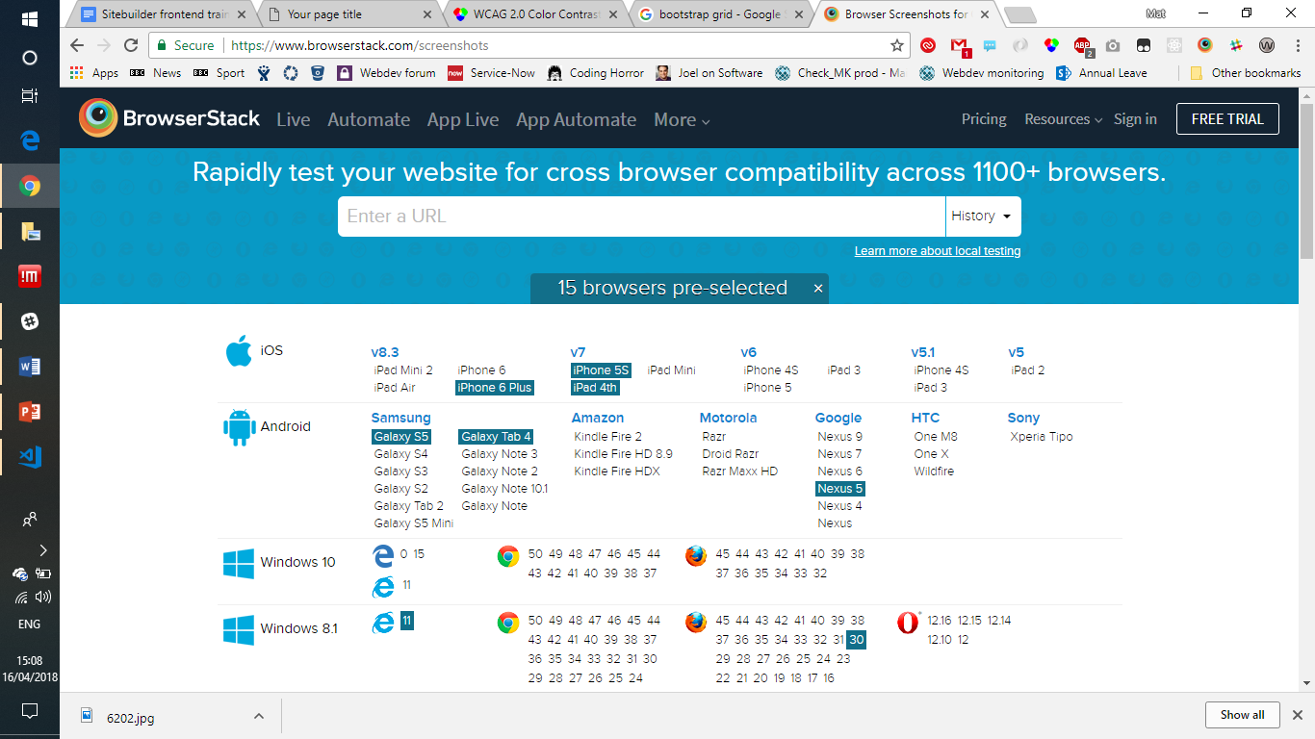
Browser testing
Your pages must work in supported browsers
Chrome, Firefox, IE11, Edge, Opera, Safari
Browser compatibility has come a long way – you’ll probably only need a cursory check
BrowserStack is a good tool that lets you take screenshots in lots of browsers – https://browserstack.com/screenshots
BrowserStack also has a paid service where you can use any browser through your web browser, good for spotting (and fixing) behaviour bugs
Notes:
Web browsers use different layout engines and sometimes there are differences in what features are supported, or how they react in certain situations. This is a lot better than it used to be!
The supported browsers (warwick.ac.uk/browsersupport) are Chrome, Firefox, Internet Explorer 11, Microsoft Edge, Opera and Safari. For most of your layouts, you’ll only need to make a cursory check to make sure it displays correctly in each of these - BrowserStack is a good tool that lets you take screenshots in lots of browsers. browserstack.com/screenshots
BrowserStack also has a paid service where you can use any browser on any operating system, this is really good for spotting behavioural bugs and debugging them (as you can usually use the browser tools in the actual browser) and this includes mobile browsers.

Slide 41
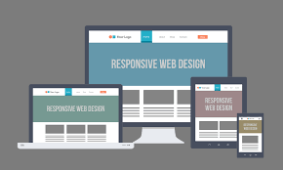
Responsive design
Your page must work well on mobile and tablet as well as desktop
Know your audience – e.g. /study and below approximately 35% on mobile
Use @media to target certain sizes to re-flow your layout appropriately (start out with mobile and then target larger displays)
Hide content that isn’t necessary on mobile (hidden-xs class)
Use hidden-print, visible-print-block, visible-print-inline, visible-print-inline-block to manage how your page displays when printed
Notes:
Big part of knowing your audience - what kind of device are your users looking at your website on? It’s all well and good designing web pages to be beautiful on your office PC but if your audience uses a mobile phone it needs to work well for them as well. If you’re looking at /study (and below), around a third of all users are on a mobile device.
Hide content that isn’t necessary, make sure your content flows semantically in the correct order, collapse down columns into a single column on mobile. Start off designing your page with mobile in mind, then enhance it for desktops at breakpoints as it gets bigger.
Usually you have elements on your page that you want to hide when it’s printed. You can add the hidden-print CSS class (or the various visible-print-block, visible-print-inline, visible-print-inline-block) to change how the page is displayed when it’s printed, or you can use @media print in your less file.

Slide 42
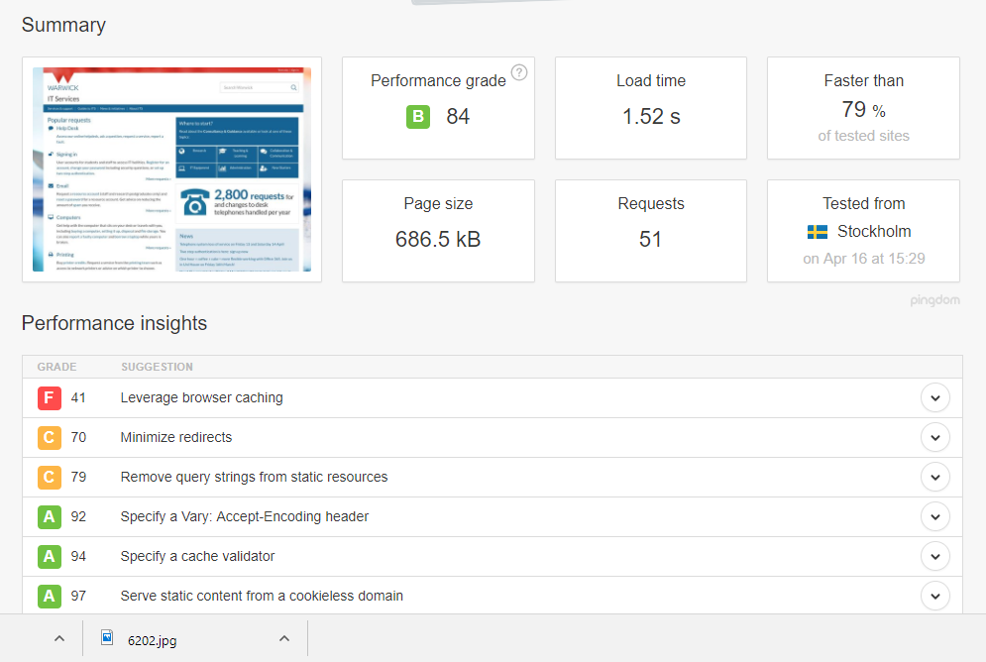
Page size (weight)
Pingdom website speed test https://tools.pingdom.com/
Know your audience – other countries? Slow connections?
Can simulate slow connections with browser dev tools
Notes:
Pingdom website speed test at https://tools.pingdom.com/
Consider the time it takes to load (less than a couple of seconds!) and the page size itself (<1.5mb). Remember your audience again, will your audience be looking at your pages from other countries (perhaps with internet restrictions or slow connections)? What’s the experience like for them?

Slide 43

Chrome Dev Tools
Dev tools in all browsers, but Chrome and Firefox have the best
Console – JavaScript errors, page information
Elements – current state of page HTML and CSS
Right click > Inspect element
Great for seeing what the current CSS value is, or why your value is being overridden
Network – request timeline
Audits – check your page against standards
Toggle device toolbar – make your page act like it’s on a mobile device
Notes:
There are a lot of useful things in browser dev tools (e.g. Chrome) that you can use to work out why something isn’t quite working or manipulate the page. Dots > More Tools > Developer tools
Console - any errors in your JavaScript will show here
Elements - the source of the page (as it currently is). You can also Right click > Inspect to go straight here with it highlighted, then you can see CSS that’s applied in the tab below
Sources - see all the elements included in the page
Network - see all the requests (you might need to refresh the page)
Performance/Memory/Application/Security - shouldn’t be needed (low-level stuff)
Audits - handy to check standards against your page. Don’t worry about the Progressive Web App audit, but it’s worth seeing what comes out of the others and whether there’s anything you can change to improve experience
Toggle device toolbar - good to see what your page is like on a particular mobile device

Slide 44

Notes:
Coffee break

Slide 45
Flexbox and CSS grid
Both reasonably recent CSS features that are for laying out content
Flexbox – laying out content in a single direction (row or column)
Grid – doing both at once
You can use both at the same time
BEWARE DRAGONS: Here is where you’ll run into browser incompatibility and bugs
…but both are (reasonably) well supported in browsers
Notes:
It’s becoming more and more common to need to use advanced layouts to be able to get pages to look like you want them to. There’s two main CSS features to use here; flexbox (for aligning and spacing elements in a single direction) and CSS grids (for aligning and spacing elements in two directions).
BEWARE DRAGONS: This is where you’re most likely to see browsers behaving differently.

Slide 46
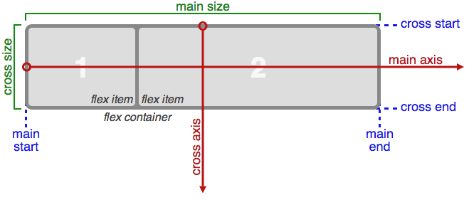
Flexbox
Position, size and space elements in a single direction
A flex container contains one or (more usefully) more flex items laid out across the main axis and aligned across the cross axis
Can be either horizontal (row) or vertical (column)
By default, will fit all the items into the available space and size them appropriately
Notes:
Used to layout content in a single dimension where the contents of the items is of unknown width/height (or can change dynamically). Layout will change to best fit the available space.

Slide 47
Flex container properties
.flex-container {
display: flex; /* or inline-flex */
flex-direction: row; /* or row-reverse or column or column-reverse */
flex-wrap: nowrap; /* or wrap or wrap-reverse */
justify-content: flex-start; /* or flex-end or center or space-between or space-around or space-evenly */
align-items: stretch; /* or flex-start or flex-end or center or baseline */
align-content: stretch; /* or flex-start or flex-end or center or space-between or space-around */
}
Notes:
There are a few properties we can set on the flex container that controls how the items are laid out inside it.
display: flex or inline-flex (equivalent to block and inline)
flex-direction: row and column are obvious, row-reverse goes right to left and column-reverse goes bottom to top
flex-wrap: by default it will try and keep items on one line but if you wrap they’ll go into multiple lines from top to bottom (-reverse: bottom to top)
justify-content: alignment along the main axis (distribute left-over free space)
align-items: alignment across the cross axis
align-content: align lines across the cross axis (when there is more than one line, i.e. flex-wrap)

Slide 48
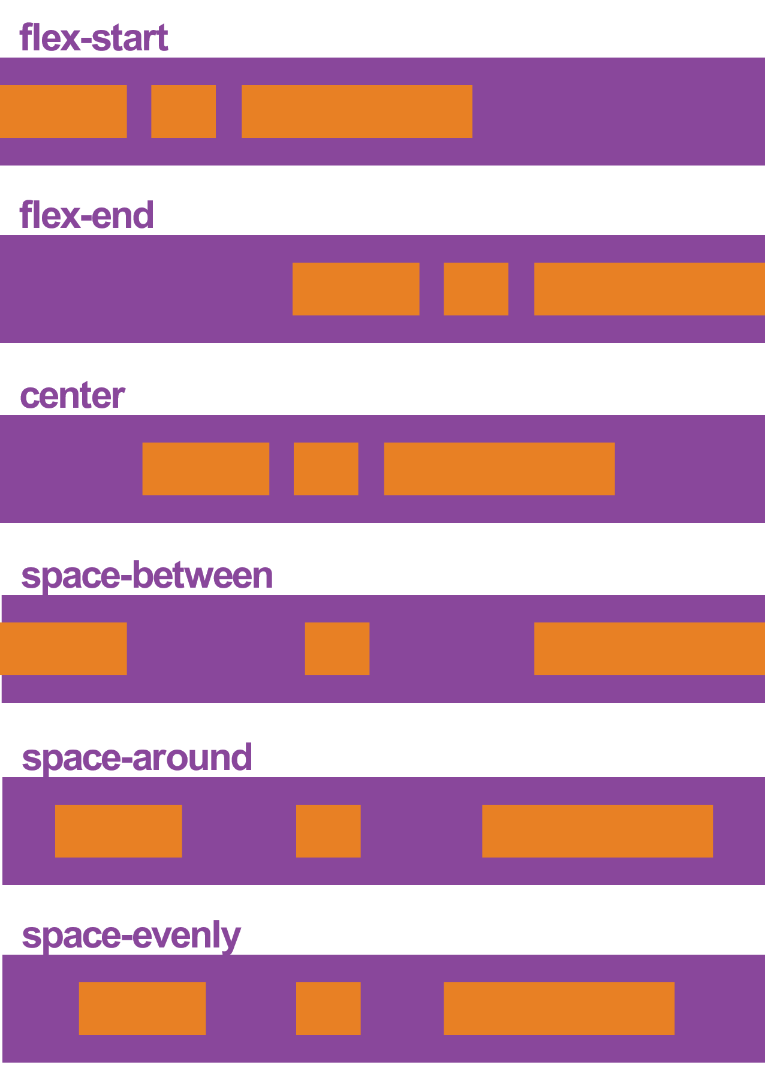
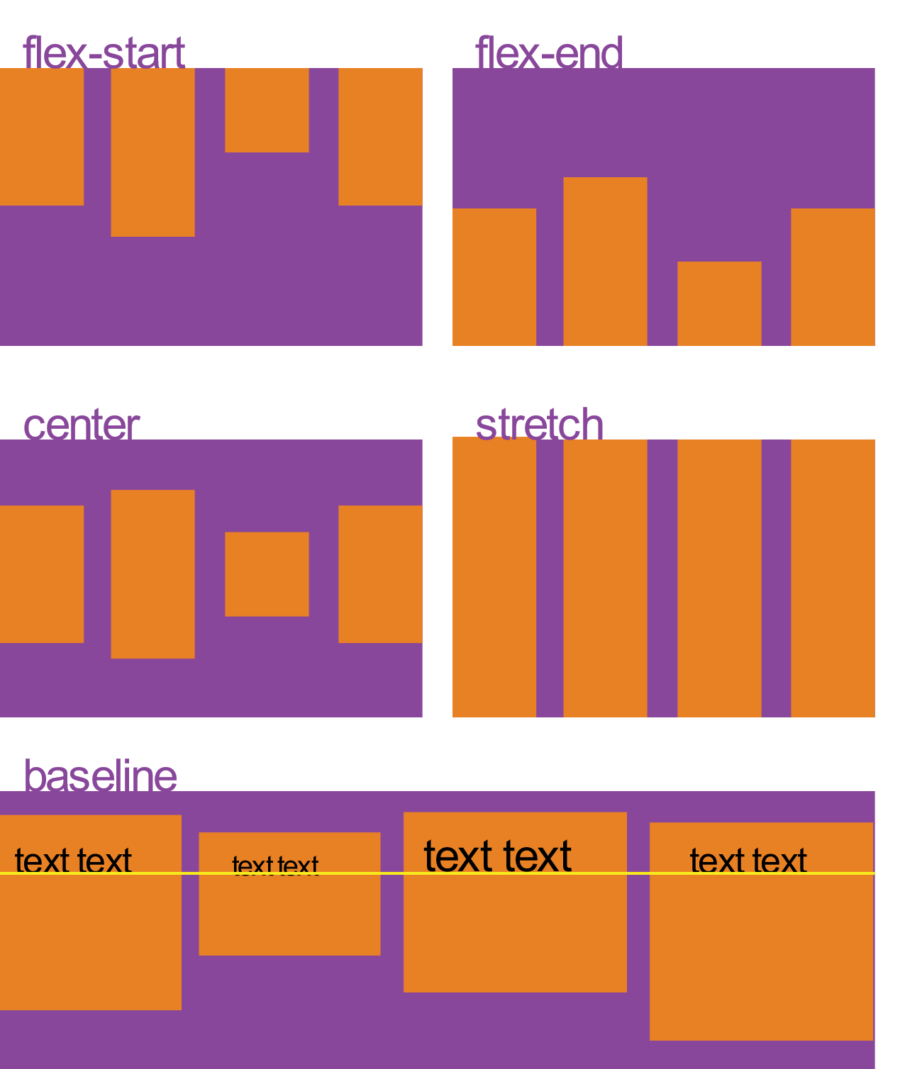
justify-content
align-items

Slide 49
Flex item properties
.flex-item {
flex-grow: 0;
flex-shrink: 1;
flex-basis: auto; /* or 100px, 10%, 3em etc. */
flex: 0 1 auto; /* this is short-hand for the 3 properties above */
align-self: auto; /* or flex-start or flex-end or center or baseline or stretch */
order: 0;
}
Notes:
There are a few properties we can set on the flex item that controls individual sizing
flex-grow: the proportion that an individual item can grow in size to fill available space. If all items had flex-grow: 1, they’d get remaining space distributed equally; if one had flex-grow: 2 it’d get twice as much
flex-shrink: the proportion that a flex item should shrink, if necessary, to accommodate other items
flex-basis: the initial size of an item before any remaining space is distributed. “auto” means “look at my width or height property”
flex: shorthand for specifying the 3 items above at once
align-self: override align-items on the container, for this item only
order: change the order that items are laid out (by default, in the same order they appear in the source)

Slide 50
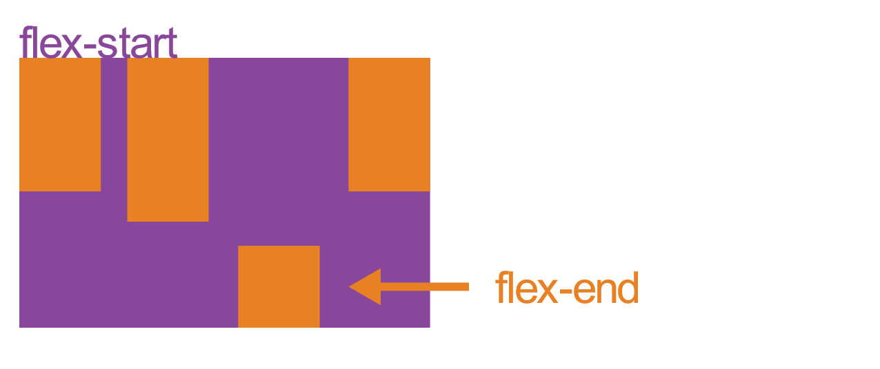
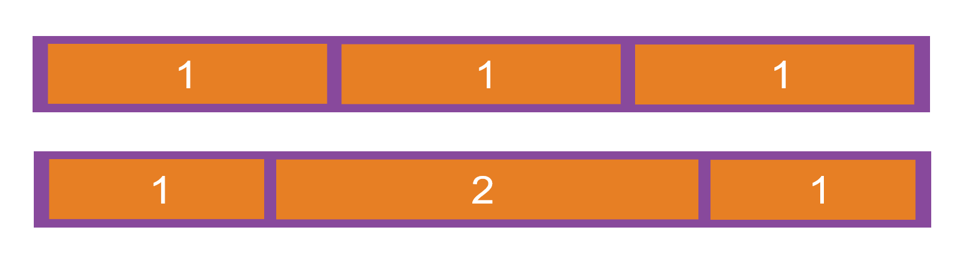
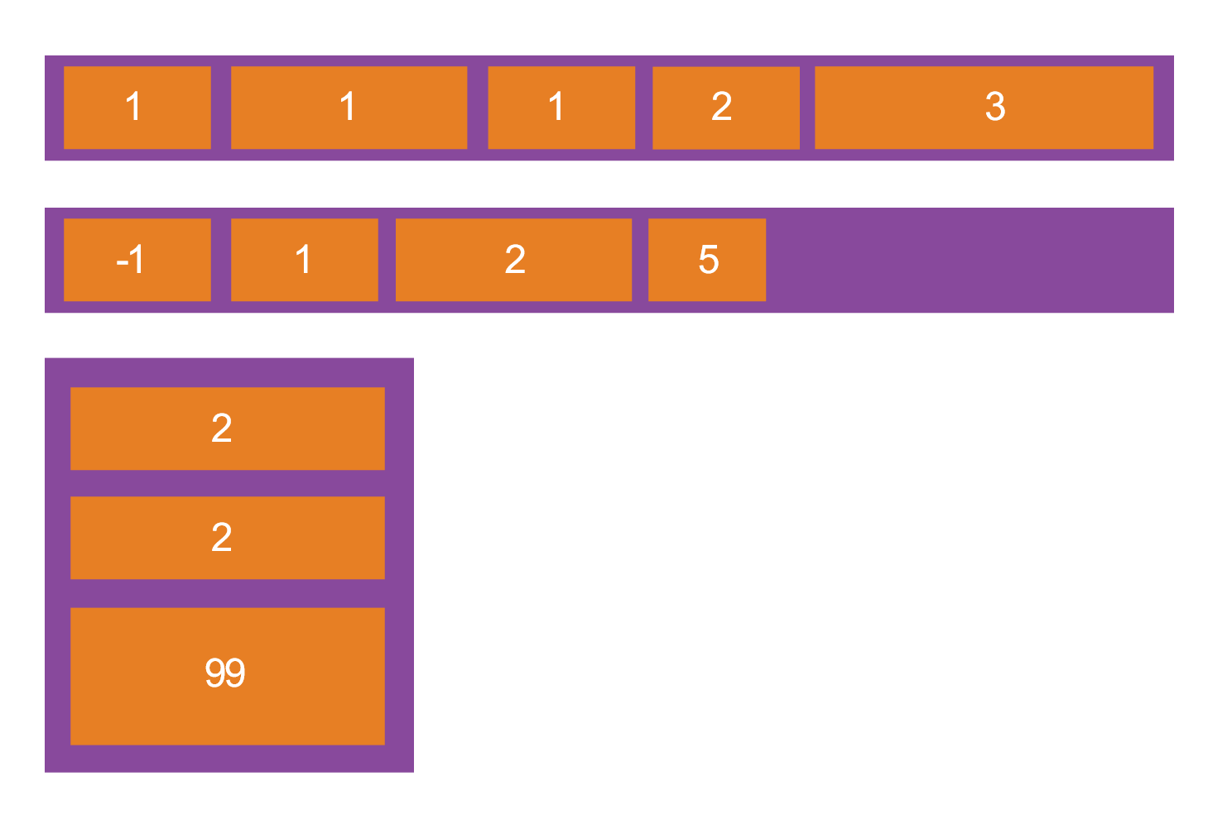
flex-grow
align-self
order

Slide 51
Exercise 4.1: Equal width and height columns (30 minutes)
Use flexbox to design a 3-column layout that lays out 3 boxes so they have the same width and height. Each box has a button at the bottom that should be pinned to the bottom of the box.
Extra time exercise: Allow the columns to wrap at the sm and md screen size, and change the order so the third column appears first

Slide 52
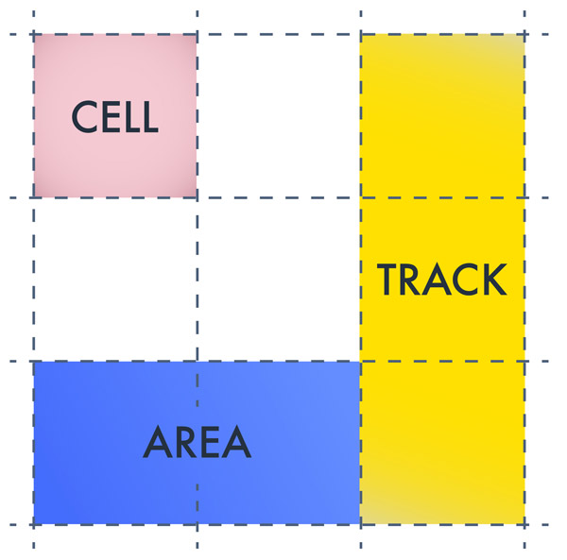
CSS Grid
Flexbox, but in two directions, with all the bells and whistles
You specify your rows and columns up front, then set positioning on each element. Order doesn’t matter just like flexbox so you can change layout entirely with media queries
A grid container contains many grid items
Grid lines make up the structure of the grid, both horizontally and vertically
Grid tracks are the spaces between lines – a whole row or column
Grid cells are single items on the grid and grid areas are collections of cells spanning multiple columns or rows
Notes:
It’s a bit like Flexbox, but 2-dimensional.

Slide 53
A note on IE
IE 11 (and IE 10) support CSS grids, but with an old version of the syntax. If you use the normal CSS grids syntax in normal .css files, they likely won’t work in IE 11
When you use a .less file in Sitebuilder, we process the output to make it work in lots of browsers (using autoprefixer) – so as long as you use a .less file in Sitebuilder, you should design with the latest syntax
Pay close attention in your cross-browser testing for where features aren’t available in IE 11

Slide 54
Grid container properties
.grid-container {
display: grid; /* or inline-grid or subgrid */
grid-column-gap: 10px; /* spacer between columns */
grid-row-gap: 10px; /* spacer between rows */
grid-gap: 10px; /* set both grid-column-gap and grid-row-gap */
justify-items: stretch; /* or start or center or end */
align-items: stretch; /* or start or center or end */
}
Notes:
A lot of alignment properties are set on the grid container and we’ll go through them by example. There are a few other properties to be aware of:
display: grid and inline-grid analogous to flex and inline-flex. Subgrid is for grids inside grids, but where you want the row/column sizes to be taken from the parent
grid-column-gap: the space between columns on the grid in pixels, percentage or fr (free-space relative)
grid-row-gap: the space between rows on the grid in pixels, percentage or fr (free-space relative)
grid-gap: grid-row-gap grid-column-gap together
justify-items: align content inside grid items along the row axis
align-items: align content inside grid items along the column axis

Slide 55
The fr unit
Much like flex-grow and flex-shrink take relative numbers that correlate to the amount of free space, CSS grid gives you a fr unit
e.g. grid-gap: 1fr; specifies the gap as 1 proportional unit of the remaining free space. 2fr is twice the proportion of 1fr
Free space is calculated after any non-flexible items

Slide 56
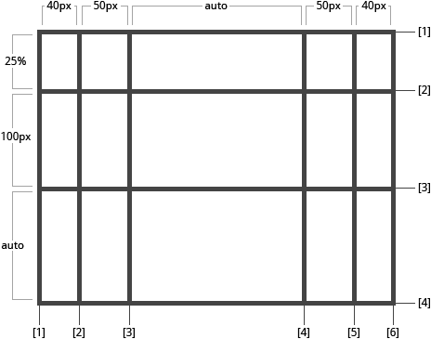
Grids by template columns and rows
.grid-container {
grid-template-columns: 40px 50px auto 50px 40px;
grid-template-rows: 25% 100px auto;
}
Notes:
Defines the columns and rows of the grid with a space-separated list of values. The values represent the track size, and the space between them represents the grid line.
When you leave an empty space between the track values, the grid lines are automatically assigned numerical names

Slide 57
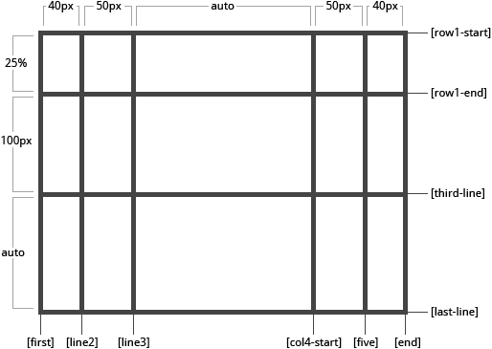
Grids by template: named lines
.grid-container {
grid-template-columns:
[first] 40px [line2] 50px [line3] auto [col4-start] 50px [five] 40px [end];
grid-template-rows:
[row1-start] 25% [row1-end] 100px [third-line] auto [last-line];
}
Notes:
But you can choose to explicitly name the lines. Note the bracket syntax for the line names

Slide 58
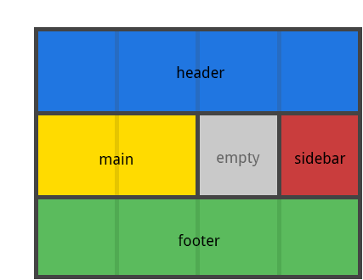
Grids by template areas
.grid-container {
grid-template-columns: repeat(4, 1fr);
grid-template-rows: auto;
grid-template-areas:
"header header header header"
"main main . sidebar"
"footer footer footer footer";
} .grid-item-a { grid-area: header; }
.grid-item-b { grid-area: main; }
.grid-item-c { grid-area: sidebar; }
.grid-item-d { grid-area: footer; }
Notes:
If your definition contains repeating parts, you can use the repeat() notation to streamline things.
Defines a grid template by referencing the names of the grid areas which are specified with the grid-area property. Repeating the name of a grid area causes the content to span those cells. A period signifies an empty cell. The syntax itself provides a visualization of the structure of the grid.
Each row in your declaration needs to have the same number of cells.
You can use any number of adjacent periods to declare a single empty cell. As long as the periods have no spaces between them they represent a single cell.
You can use grid-template to define template-rows, then template-columns, then template-areas.

Slide 59
Grid item properties
.grid-item {
grid-column-start: 1; /* or name of line. Add span before to span multiple, or auto */
grid-column-end: span 3; /* or name of line. Add span before to span multiple, or auto */
grid-column: 1 / span 3; /* shorthand for setting grid-column-start / grid-column-end */
grid-row-start: 1; /* or name of line. Add span before to span multiple, or auto */
grid-row-end: span 3; /* or name of line. Add span before to span multiple, or auto */
grid-row: 1 / span 3; /* shorthand for setting grid-row-start and grid-row-end */
grid-area: header; /* or row start / column start / row end / column end */
justify-self: stretch; /* or start or center or end */
align-self: stretch; /* or start or center or end */
}
Notes:
Most grid item properties are about sizing.
grid-column/row: set where the item starts and ends to define an area
grid-area: set row and column together or use a named area from grid-template-areas on the container
justify-self: align content inside grid item along the row axis
align-self: align content inside grid item along the column axis

Slide 60
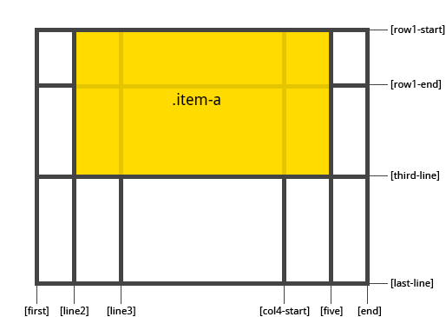
Grids item sizing
.item-a {
grid-column-start: 2;
grid-column-end: five;
grid-row-start: row1-start;
grid-row-end: 3;
}

Slide 61
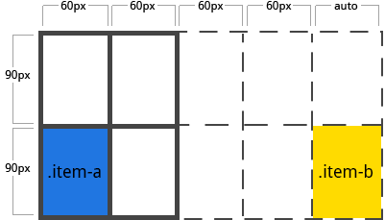
Auto rows and columns
.grid-container {
grid-template-columns: 60px 60px;
grid-template-rows: 90px 90px;
grid-auto-columns: 60px;
}
.grid-item-a {
grid-column: 1 / 2;
grid-row: 2 / 3;
}
.grid-item-b {
grid-column: 5 / 6;
grid-row: 2 / 3;
}
Notes:
Define implicit grid tracks by using grid-auto-columns or grid-auto-rows. So if we try and place an item outside of the grid, it specifies the size of the auto-created rows/columns
We’ve only defined a 2x2 grid here but placed an item between line 5 and 6 on the second row.

Slide 62
Exercise 4.2: Implementing insite with CSS grid (30 minutes)
Insite uses a design with flowing boxes that span across multiple grid tracks
Implement a design that uses grid auto placement to place items on the grid as necessary
Extra time exercise: Have the grid only activate at sm and be 2 columns wide at sm and 3 columns wide at md (remaining 4 columns wide at lg only)

Slide 63

Please fill in the feedback form or I’m never doing this again
Notes:
YOU’RE WINNER

